Slide 1
FINDBUGS – MYECLIPSE Plugin Installation

Slide 2
Follow the steps
Click Help -> MyEclipse Configuration menu in the MyEclipse application.
Select Software tab
Click add site link, the Add update site will open
Add Values –
Name – FindBugs
URL - http://findbugs.cs.umd.edu/eclipse

Slide 3
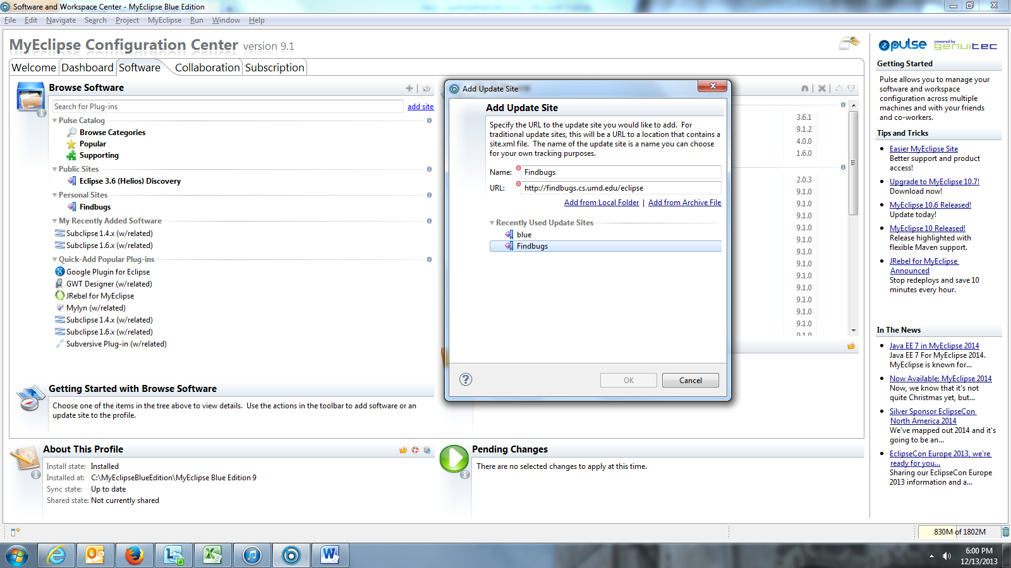

Slide 4
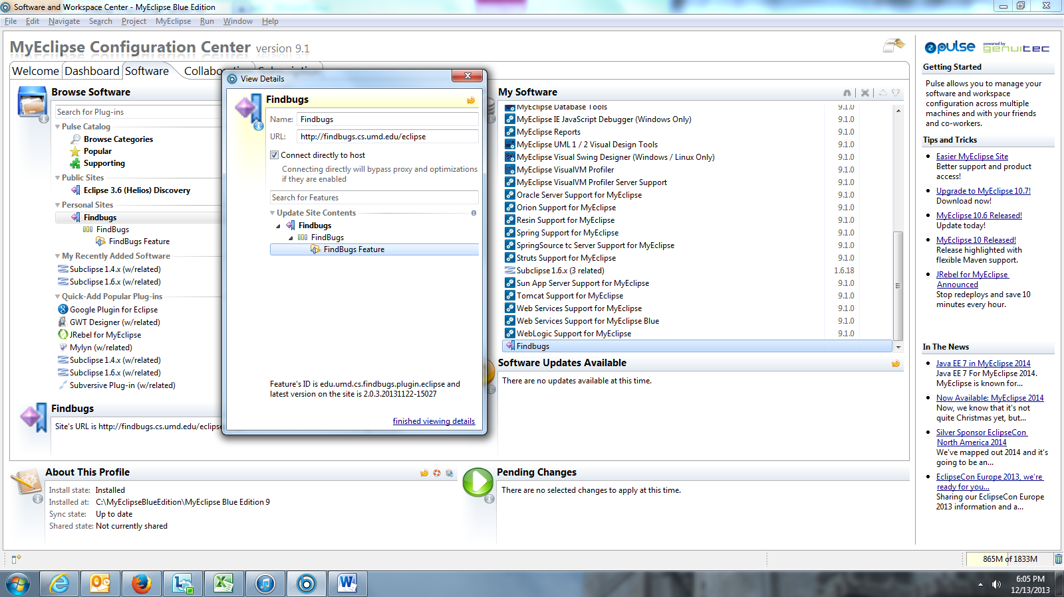
Add the FindBugs software to My Software

Slide 5
You should see FindBugs Feature details in Software Updates Available and Pending Changes
Install, Select the I accept option to accept the license and click Next
Click Yes to make Eclipse restart itself

